Slide 1
Looking ahead
Programming And Scripting
Andrew.Beatty@atu.ie

Slide 2
Modules
You will be using modules that already exist (anaconda has a lot already installed
Pip (comes with python)
This week we will introduce you to
numpy
Faster at dealing with arrays of numbers
Matplotlib
Plotting data
Seaborn is built on top of matplotlib
pandas
For analysing data
$pip install modulename

Slide 3
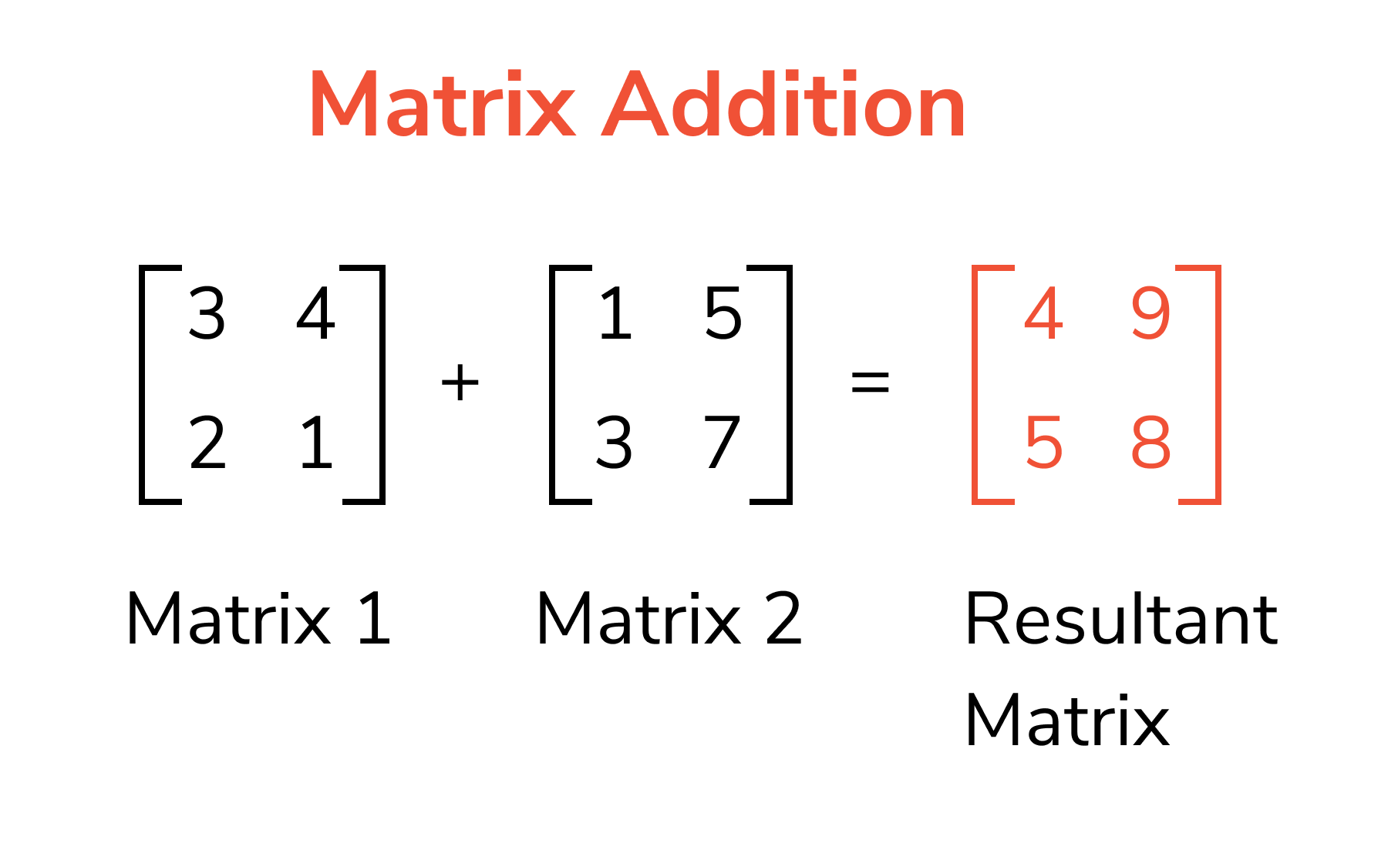
numpy
Why
Arrays
Matrix functions
Indexing multi D arrays is slightly different
Slicing the same
Numpy arrays elements should be all of the same type (types are different than built in types)
Reshaping
Combining arrays together
random number (can seed the list of random numbers)

Slide 5
Right I am keeping this short

